Slide 1


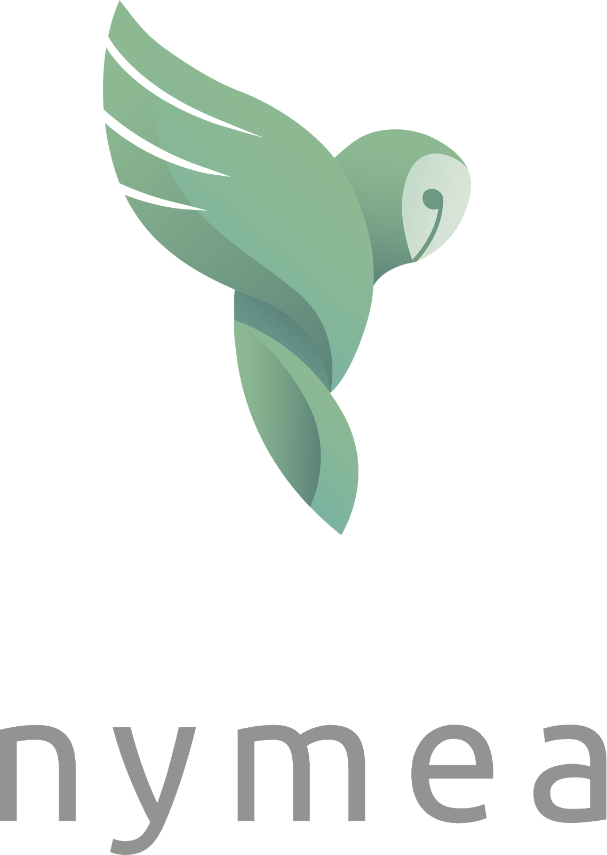
Our exciting journey of API integration

Slide 2

The Company

Slide 3
At a glance
Effortless API integration saves time and money
guh GmbH is a tech company based in Vienna/Austria founded in 2016
Founder team started to work on the product in 2013
Our product nymea is an professional M2M stack for connected “things"
Our stack guarantees effortless API integrations
We believe in the strength of integrated edge solutions
System stability and security are our top priorities
Unbeatable time-to-market/time-to-revenue

Slide 4
The Idea

Slide 5
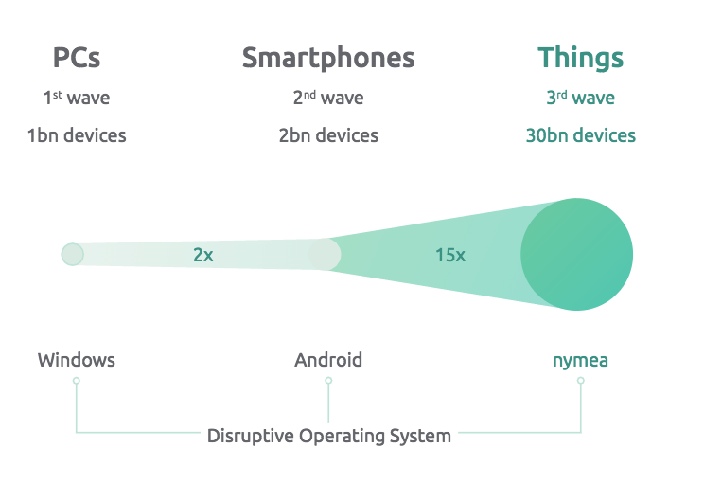
3rd wave of Internet
Estimated 30bn devices by 2020*
*MacGillivray, Carrie, Worldwide Internet of Things Forecast Update, 2015-2019, International Data Corporation (IDC), February 2016; Turner, Vernon, “The Internet of Things: Getting Ready to Embrace Its Impact on the Digital Economy,” International Data Corporation (IDC),
2 March 2016, Directions 2016: San Jose, CA.

Slide 6
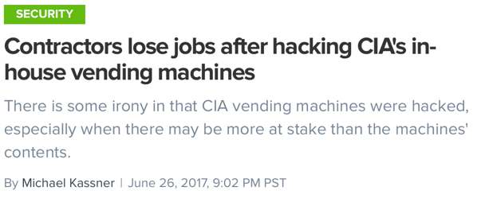
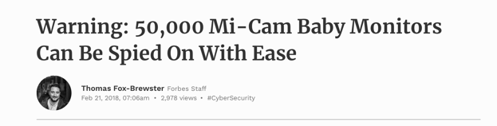
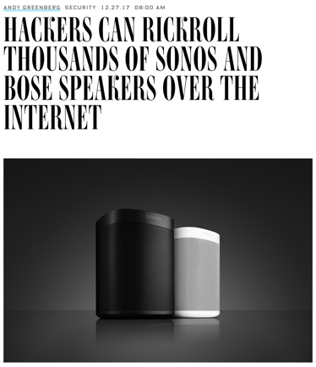
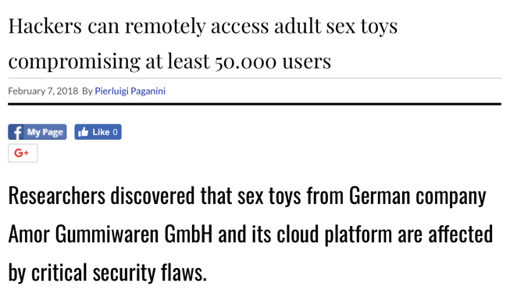
Hall of shame

Slide 7
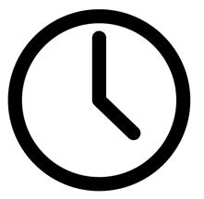
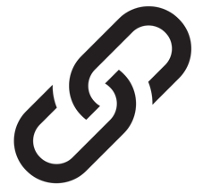
IoT Challenges
 | time-to-market
 | security
 | interdependencies
Notes:
(Aug14)
Interconnectivity loss through exponential device growth
High dependency on cloud and rapid growth of data traffic
Security problems because of outdated software
Difficulties in the monetization of IoT
Time-to-market often disappointing – small window of opportunity
ttm and toc
(communication issue) manufacturer delivers open api to the device, now others can acces the device and the manufacturer will not earn money with it. He is just enabling others to earn money;
this api is connecting your device=‘smart‘.
Also: protection against DDOS attacks

Slide 8
Markets are changing incredible fast
Disruption of established markets and business models

Slide 9
Markets are changing incredible fast
Disruption of established markets and business models
“GAFA”

Slide 10
Closer to the end consumer
Direct consumer access brings power and revenue
(1) Secure & reliable connection (2) Future proof services/business models
Notes:
(Aug 14)
Software defined product
“IoT App Store”
Security/stability first (vs. bunch of features/integrations)
Future proof: flexible/expandable (not only for one use case)
Lean start-up method

Slide 11
Our Journey

Slide 12
IoT - lessons learned so far
From a fancy smart home device to an operating system
starting point: focus of human-machine interface the best interface = no interface

Slide 13
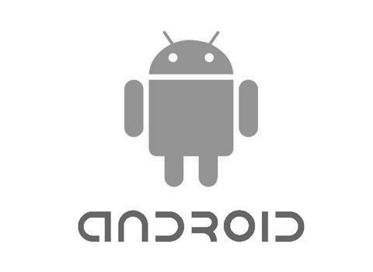
Company Vision
Build IoT devices without coding
MOBILE STANDARD
IOT STANDARD
Notes:
Vision: words and picture should be aligned (“mobile standard” versus “IoT standard”) ✓

Slide 14
IoT - lessons learned so far
From a fancy smart home device to an operating system
universal machine language
all devices with the same OS can talk to each other
teach every machine to speak every language (modular plug-ins)
Notes:
Nicht real
Nicht real
Möglich

Slide 15
“Works with…”
Every modern product has to be connected
IFTTT
Alexa
Google Home
Apple Home Kit

Slide 16
“Works with…”
Every modern product has to be connected
IFTTT
Alexa
Google Home
Apple Home Kit
nymea

Slide 17
Even better: no cloud infrastructure needed
We believe in the strength of edge computing
LAN
WAN
nymea integrated software gateway
Notes:
Lokale Datenverarbeitung - nicht gezwungen online zu sein
Verbesserte Privacy
Stabilität/Ausfallsicherheit

Slide 18
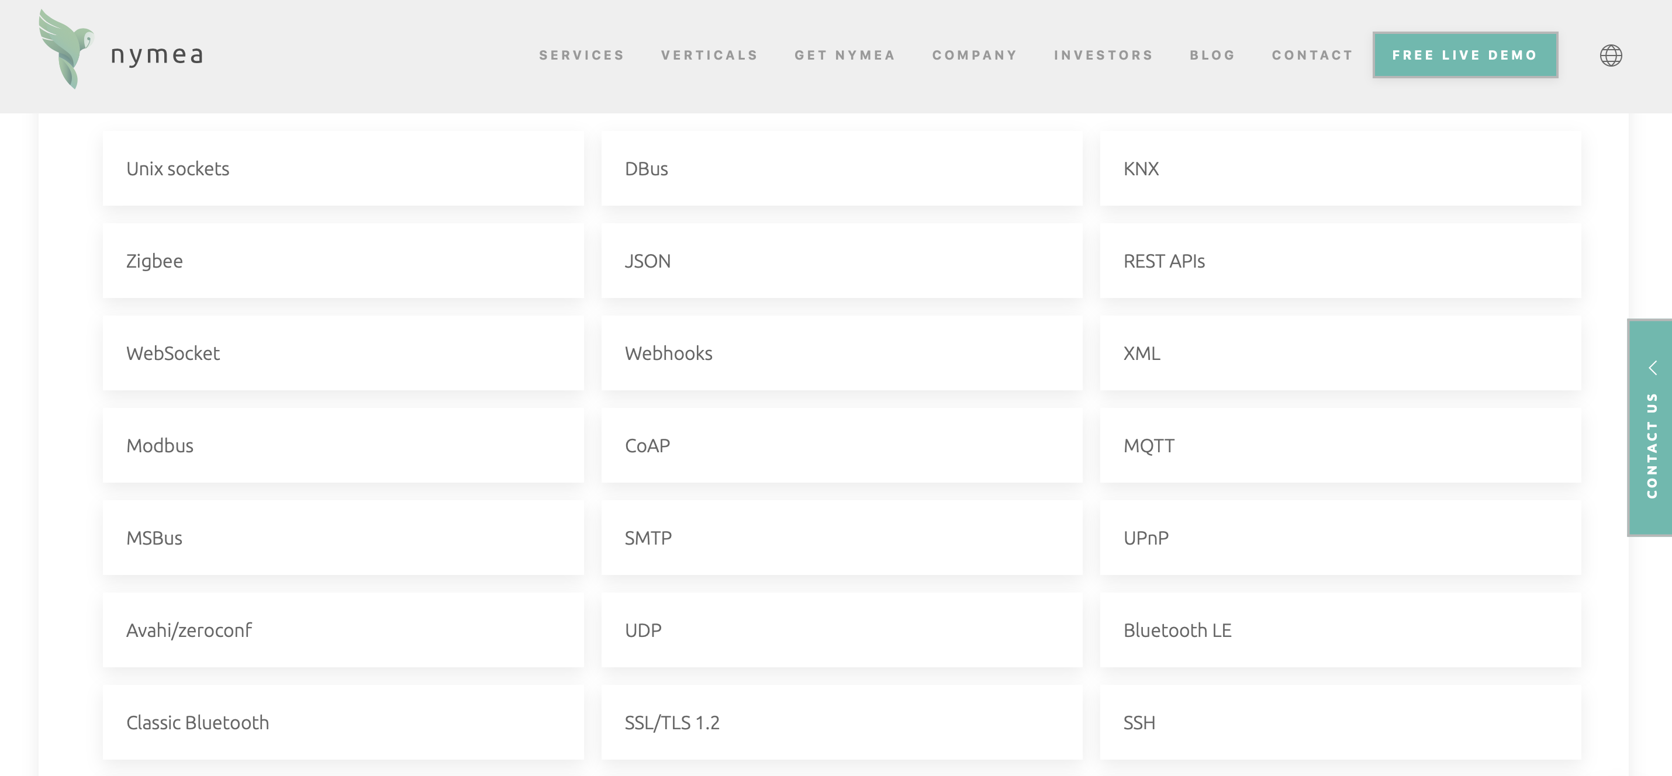
“Works with…”
Every modern product has to be connected
Notes:
Already integrated – plug-ins available, e.g. aws, KNX, …
If not yet: nymea is a fast learner

Slide 19
Final Stack and Services

Slide 20
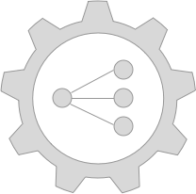
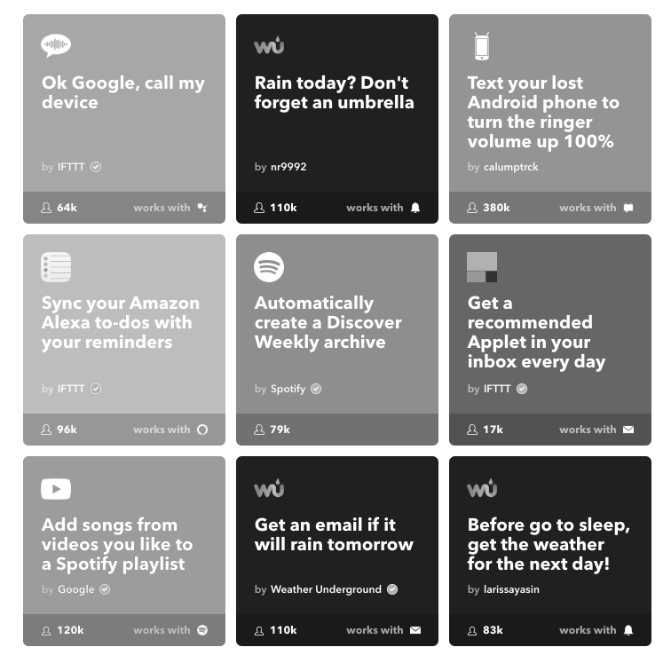
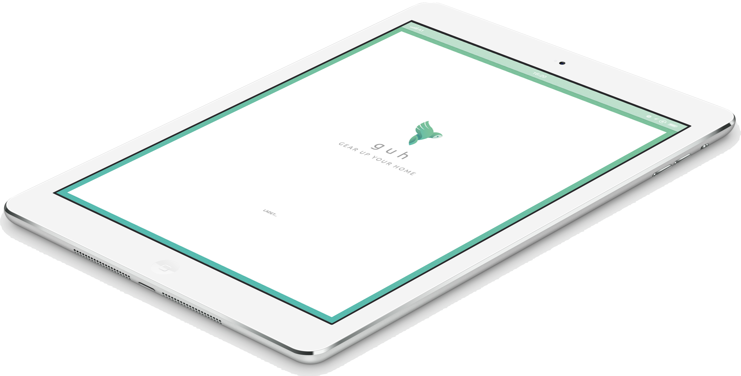
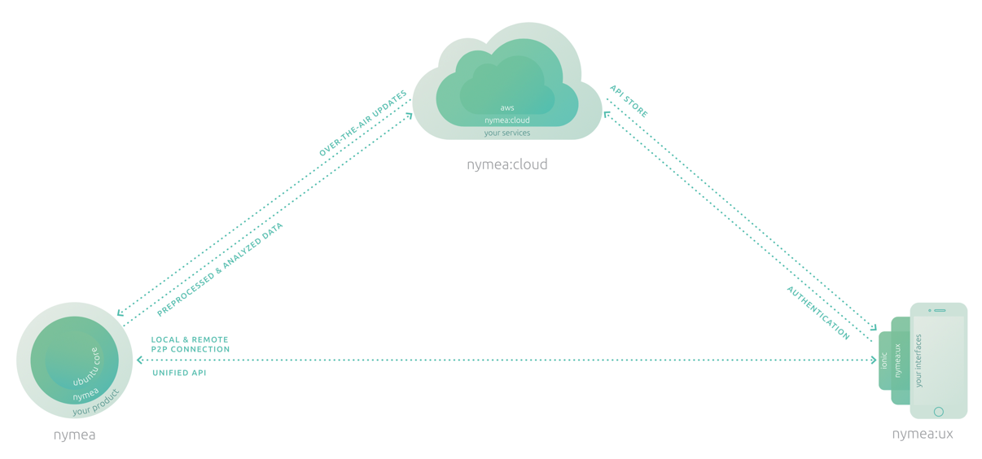
The stack
OS
Services
Apps
Notes:
Make it very simple to understand for everyone:
Install OS at the device, add Nymea App on the phone, add ‘Services’ to the cloud picture ✓
Maybe you want to add pictures ✓

Slide 21
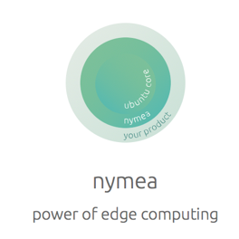
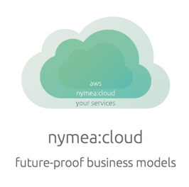
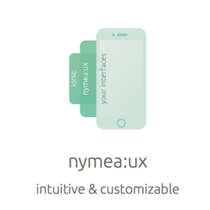

The services
Turn key solution with unbeatable time-to-market
Notes:
Key turn solution = turn key solution
Software and Services:
(left side) Nymea OS for IoT devices; after installing this OS the IoT device can be used for multiple IoT applications (software defined product). Example: install Nymea on Raspberry Pi=secured IoT device
(2) (middle picture) Cloud solution – Proactive maintenance and updates on registered devices in the cloud (the device is registered in the cloud by the Nymea team during onboarding)
(3) (right picture) customer attention by vendor – Nymea App (per device 1 install) to setup and control the IoT device

Slide 22
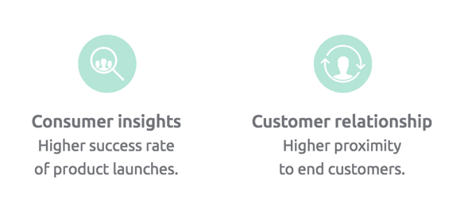
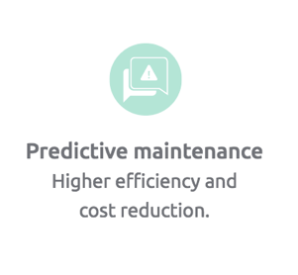
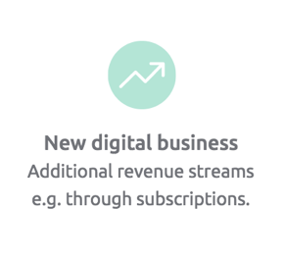
Closer to the customer
Direct consumer access is key
Direct consumer access brings power and revenue

Slide 23
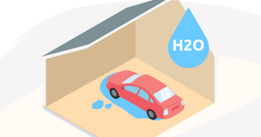
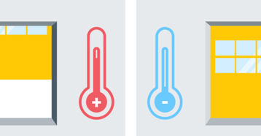

Use case
New standards for the garage door market

Slide 24
Why Qt?

Slide 25
How Qt has Increased Our Productivity
Direct consumer access brings power and revenue
Plugin architecture
Transport protocols
JSONRPC based API
Testing and debugging framework
API documentation using Qdoc
Cross platform
A ton of small helpers all along the way

Slide 26
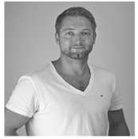
Thank you!
SIMON SERES CEO & Co-Founder simon.seres@nymea.io
www.nymea.io

Slide 27
Back-up/Notizen
Notes:
Add: board and tech leads ✓

Slide 28
The journey of API integration - Simon Seres
Grand Hotel Baglioni, Ercole
Every modern product needs to ‘work with’ other services - this fact drains development budgets through countless API and SDK integration hours at almost every company.
The original vision
was to utilise billions of IoT gadgets to build a decentralised mega-computer through open source nodes. A good bot instead of a bad bot scenario.
Simon, CEO of nymea: "We incorporated a company and started to learn. The early outcome was: There are billions of lean linux-systems working in IoT products - but those generic systems are restricted to their actual application as a printer or a heating pump. What a waste. None of the hardware producers were interested in Botnets - nevertheless they honoured the idea of machines talking to other machines.
But, after a couple of economic and technical iterations, we ended up writing software gateways and middlewares (= set of tools and libs).
The need of integrated software gateways
became more obvious. Customers wanted to attach their IoT product to all of that Microsoft Azures, or Amazons, and the demand exploded: IFTTT, Conrad Connect, Alexa, Google Home, Apple Home Kit, Zapier, Siemens Mindsphere, IBM Bluemix and hundreds of IoT clouds and products. And because nobody likes vendor lock-in, it should be easy to reattach the IoT product anytime. It should be as easy as changing from Netflix to Amazon Prime (this is no ad!).
We learned: A modern product should be able to seamlessly attach to any product or service. For many reasons.
Waiting for the best idea in the world to come true, we made the second best idea a blessing for many product managers: The best API integration stack for Linux devices. And its not a RAM-killer since it is based on Qt."
Watch Simon reporting some of his key learnings in an entertaining format.

Slide 29
Sharen von Daten kein Must
Kunde hat volle Transparenz über seine Daten je mehr Daten geteilt werden, desto besser kann Hersteller auf Bedürfnisse eingehen WAHLMÖGLICHKEIT
Zu Beginn - Marktbeobachtung: Entwicklung einer universalen MASCHINENSPRACHE: nicht realistisch
Next step: OS: alle devices mit gleichem OS können untereinander ”sprechen” -> jeder Maschine jede Maschinensprache beibringen (modulares Einbinden von Plug-ins/APIs)

